Slide 1
UNIT V – Tables & Sets
SCS1201 – Advanced Data Structures
Semester III / Year II

Slide 2
Content
1
Tables
Rectangular Tables
Jagged Tables
Inverted Tables
Symbol Tables
Static Tree Tables
Dynamic Tree Tables
Hash Tables
2
Sets
Representation
Operations
Applications

Slide 3
Tables
Plays a significant role in information retrieval
Stored as (key, value) pair.
To find a record with a given key value, k, access the index by its key.
Example:
Your name and the associated telephone number in the telephone book
Key – name
Value – telephone number

Slide 4
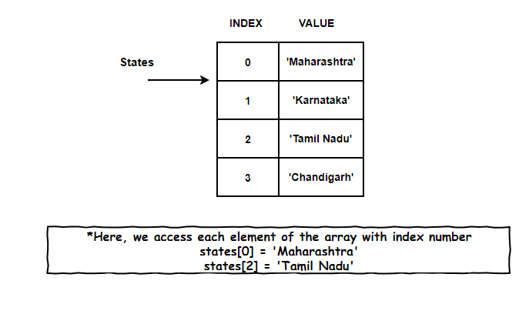
Tables

Slide 5
Typical operations on tables are:
Insert a (key, value) pair into the table;
Remove a key from the table (along with its associated value);
Look up a key and find the associated value, or say that the key does
not occur in the table.

Slide 6
Table Types
Rectangular Tables
Jagged Tables
Inverted Tables
Symbol Tables
Static Tree Tables
Dynamic Tree Tables
Hash Tables

Slide 7
Rectangular Tables
2D Tables with Rows and Columns
Example: Arrays
Rectangular Tables are otherwise referred as “MATRIX”
Arrays
Row Major
Column Major

Slide 8
Rectangular Tables
3 x 4 Rectangular Table
 | 0 | 1 | 2 | 3
0 | D | A | T | A
1 | H | A | S | H
2 | T | W | O | D
Row Major Order
D | A | T | A | H | A | S | H | T | W | O | D
Column Major Order
D | H | T | A | A | W | T | S | O | A | H | D

Slide 9
Rectangular Tables
For an m X n array ( m – rows and n – columns )
Each row is indexed from 0 to m - 1
Each column is indexed from 0 to n – 1
The element at (i, j) is at the sequential position
i X n + j where n is the number of columns. (Row major order)
j X m + i where m is the number of rows (Column major order)

Slide 10
Row Major Arrangement (Linear)
D | A | T | A | H | A | S | H | T | W | O | D
0 |  |  | n-1 | n |  |  | 2n-1 | 2n |  |  | 3n-1
Row1 |  |  |  | Row2 |  |  |  | Row3

Slide 11
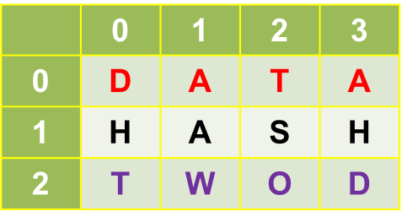

Finding address in row major order
To find the address of the item at location (1,2) in row major order:
i x n + j
= 1 x 4 + 2
= 6
0 1 2 3 4 5 6 7 8 9 10 11

Slide 12
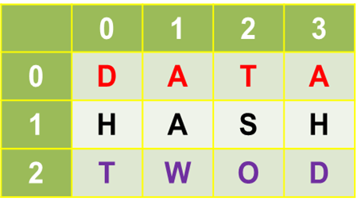
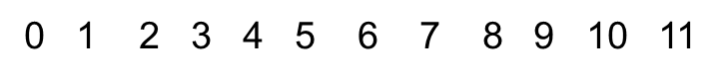
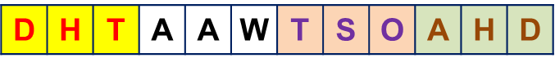
Finding address in column major order
To find the address of the item at location (2,3) in column major order:
j x m + i
= 3 x 3+ 2
= 11

Slide 13
Jagged Table
Special kind of
Sparse Matrices.
Triangular Matrices
Band Matrices
In the jagged table, the elements in a row or a column (present) should be contiguous.

Slide 14
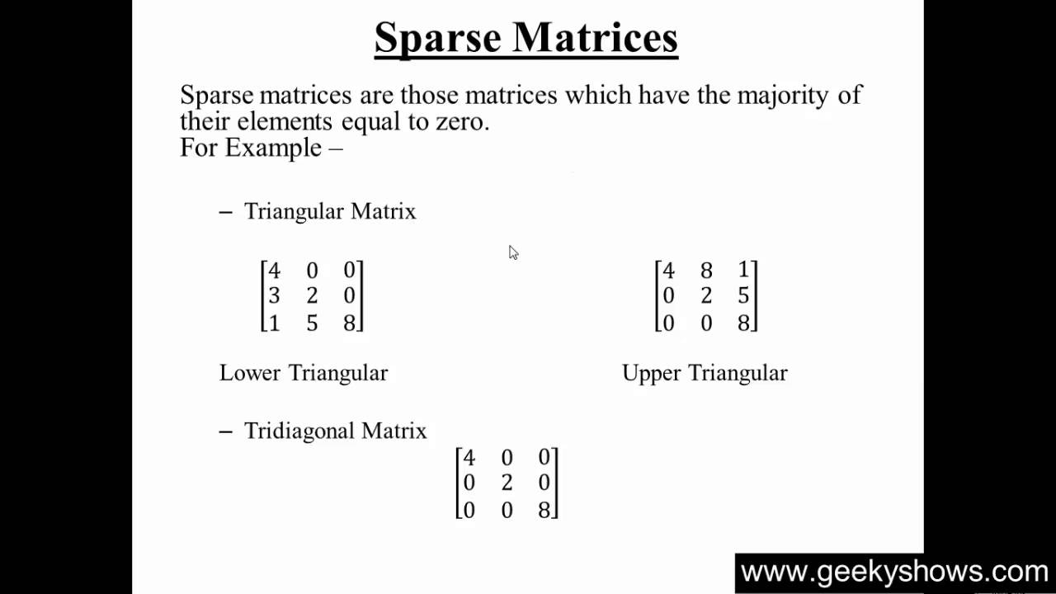

Slide 15
Examples
* | *
* | * | *
 | * | * | *
 |  | * | * | *
 |  |  | * | *
 |  |  |  | *
* | * | * | *
* | * | * | * | * | *
* | * | * | *
* | * | * | * | * | *
* | * | * | *
* | * | * | * | * | *
*
* | *
* | * | *
* | * | * | *
* | * | * | *
* | * | * | * | *
- | - | * | * | - | -
* | * | - | - | * | *
- | - | * | * | - | -
* | * | - | - | * | *
- | - | * | * | - | -
* | * | - | - | * | *
* | * | * | * | *
 |  |  | *
 |  | *
 | *
* | * | * | * | *

Slide 16
Access Table
Calculated only once at the time of initiation.
Stored in memory
Referred each time when the element in the jagged table is accessed
Requires only addition
0, 1, (1 + 2), (1 + 2) + 3, …

Slide 17
Example
I
H | E
S | H | E
Y | O | U | R
T | H | E | I | R
M | Y | S | E | L | F
I | H | E | S | H | E | Y | O | U | R | T | H | E | I | R | M | Y | S | E | L | F
Jagged Table
Row Major Order
I | H | E | S | H | E | Y | O | U | R | T | H | E | I | R | M | Y | S | E | L | F
Access a₅₄:
5th Row, 4th Col
5th Location in access table = 10
Desired element = 4
Location = 10 + 4 = 14
Value = “I”
1 | 0
2 | 1
3 | 3
4 | 6
5 | 10
6 | 15
Access Table

Slide 18
Example
0 |  | * | * | * | *
4 |  | * | * | * | * | * | *
10
10 |  | * | * | * | *
14 |  | * | * | * | * | * | *
20
20 |  | * | * | * | *
24 |  | * | * | * | * | * | *

Slide 19
Exercise
* | * | * | * | *
 |  |  | *
 |  | *
 | *
* | * | * | * | *
 |  |  |  |  |  | *
 |  |  |  |  | * | * | *
 |  |  |  | * | * | * | * | *
 |  |  | * | * | * | * | * | * | *
…………..
* | * | … | * | * | * | * | * | * | … | * | *

Slide 20
Consider the following table
Sr. No. | Register Number | Roll Number | Student Name
1 | 37110001 | 17SCS0151 | GUNDA AAKASH
2 | 37110003 | 17SCS0003 | AAVUNOOR RUTHWIK BHARADWAJ
3 | 37110005 | 17SCS5003 | ABHINAV SINHA
4 | 37110573 | 17SCS0348 | POTHAMSETTI GANESH SAI NADH REDDY
5 | 37110575 | 17SCS8075 | POTHININDI SHANKAR CHANDRA
6 | 37110002 | 17SCS5002 | AAKKASH SHREYAN M
7 | 37110004 | 17SCS8001 | ABBAREDDY SAIKRISHNA
8 | 37110574 | 17SCS0350 | POTHINA ABHILASH CHOWDARY
9 | 37110576 | 17SCS0351 | POTHIREDDY GOKUL REDDY
10 | 37110577 | 17SCS0352 | POTLA LAKSHMI PRASANNA

Slide 21
Inverted Tables
Sorting can be done on
Register Number
Roll Number
Student Name
Will leads to
Additional storage
Modification of Records

Slide 22
Inverted Table
With Inverted Tables:
Retrieve the records based on any field in sorted order
Inverted Table maintains the
index numbers of column
Sorted on the respective key

Slide 23
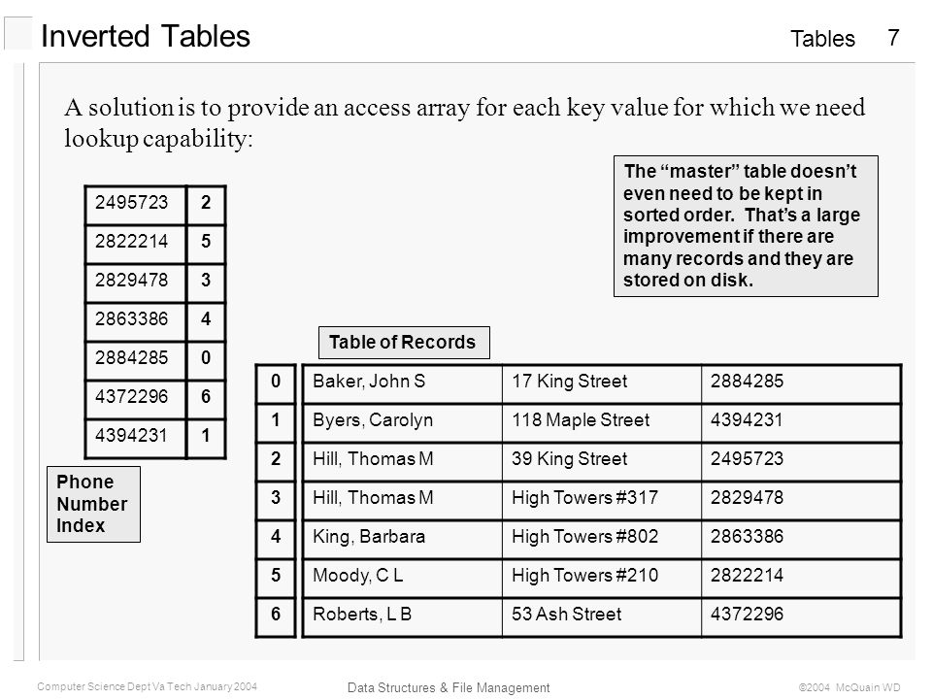

Slide 24
Symbol Tables
To store information about the presence of various entities. Entities are:
Variables
Function names
Interfaces
Objects
Classes
Used in compilers.
Analysis
Synthesis

Slide 25
Symbol Tables
Depends on the programming language:
Store the name of all entities in a structured form at one location
Verification of declaration of a variable
Semantic verification of
Assignment
Expressions
Determining the scope of a name.
Represented either as
Linear
Hash
Format:
<symbol name, type, attribute>

Slide 26
Example
Declaration of statement in C Programming language:
static float rateOfInterest;
Symbol Table Entry:
<rateOfInterest, float, static>
Symbol Tables can be implemented as:
Linear List (Sorted / Unsorted)
Binary Search Tree
Hash Table

Slide 27
ADT of Symbol Table
insert()
Used in analysis phase
To add the unique symbols / names in the source code
Symbol Attribute: value, state, scope, type
Example:
int a;
insert(a, int)

Slide 28
ADT of Symbol Table
lookup()
To search the name in a symbol table for determining
Occurrence of Symbol in the table
Declared before using the symbol
Name is used in the scope
Symbol is initialized
Declaration of same symbol in multiple times
Example:
lookup(a)
Returns 0 – if the symbol is not declared
Returns the attributes from the table if the symbol is declared

Slide 29
Scope in Symbol Table
Two types of symbol tables
Global Symbol Table
Scope Symbol Table
Consider the following code
int a = 1;
void function_1(){
int a_1;
float a_2; {
int a_2_1;
int a_2_2;
}
char a_3; {
int a_3_1;
int a_3_2;
}
}
…
int function_2(){
int b_1;
Int b_2; {
int b_2_1;
int b_2_2;
}
int b_3;
}
…

Slide 30
Symbol Table
void function_1(){
int a_1;
float a_2; {
int a_2_1;
int a_2_2;
}
char a_3; {
int a_3_1;
int a_3_2;
}
}
Global Symbol Table
int function_2(){
int b_1;
Int b_2; {
int b_2_1;
int b_2_2;
}
int b_3;
}
Value | Var | Type
function_1 | function | void
function_2 | function | int
Function 1
Symbol Table
a_1 | var | int
a_2 | var | float
a_3 | var | char
b_1 | var | int
b_2 | var | int
b_3 | var | int
Function 2
Symbol Table
a_2_1 | var | int
a_2_2 | var | int
a_3_1 | var | int
a_3_2 | var | int
b_2_1 | var | int
b_2_2 | var | int
Inner Scope 1
Inner Scope 2
Inner Scope 3

Slide 31
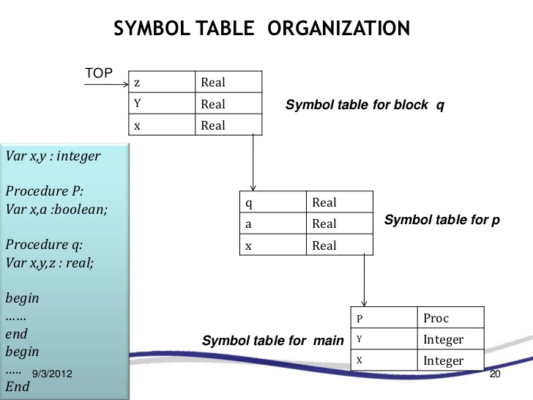

Slide 32
Representation of symbol table
Static tree table
Dynamic tree table

Slide 35
Hash Table
Data is stored in Associative manner- The data is mapped to array
positions by a hash function.
Data has its own index value and is represented as Array
Index of data known, time required to access the same is minimal
The memory where the keys are stored is called as hash table
Properties:
Partitioned into ‘n’ buckets: HT[0], HT[1], …, HT[n-1]
Each bucket is capable of holding ‘i’ records.
A bucket consist of ‘i’ slots. Each slot holds one record
Usually i = 1 and every bucket holds exactly one record

Slide 36
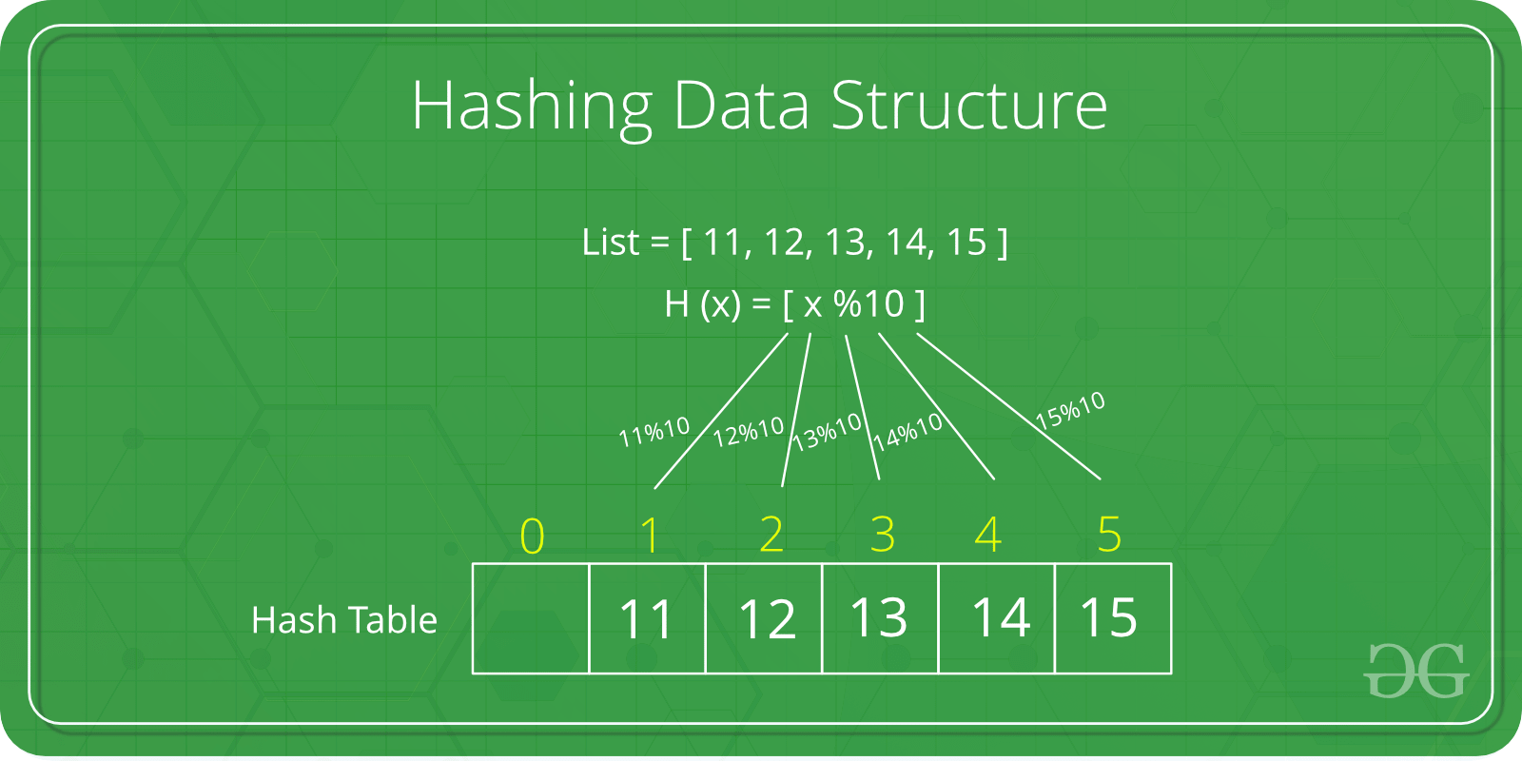

Slide 37
Hashing Techniques
The hashing technique is the method in which the address or location of a key ‘k’ is obtained by computing some arithmetic function ‘f’ of k. f(k) gives the address of k in the table. The address will be referred to hash address or home address.
Hashing function f(k): The hashing function used to perform an identifier transformation on k. f(k) maps the set of possible identifiers onto the integer 0 through n-1.
Overflow: An overflow is said to occur when a new identifier k is mapped or hashed by f(k) into a full bucket.
Collision: A collision occurs when two non-identical identifiers are hashed into the same bucket.

Slide 38
Hashing Technique
Key 1
index | value
0 | Value 1
1 | Value 2
2 | Value 3
3 | Value 4
4 | Value 5
Key 2
Hash Function
Key 3
Key 4
Key 5

Slide 39
Example
Size of Hash Table = 20
f(k) = k mod 20
Key | Value
1 | 20
2 | 70
42 | 80
4 | 25
12 | 44
14 | 32
17 | 11
13 | 78
37 | 98
Key | Hash | Array Index
1 | 1 Mod 20 | 1
2 | 2 Mod 20 | 2
42 | 42 Mod 20 | 2
4 | 4 Mod 20 | 4
12 | 12 Mod 20 | 12
14 | 14 Mod 20 | 14
17 | 17 Mod 20 | 17
13 | 13 Mod 20 | 13
37 | 37 Mod 20 | 17

Slide 40
Collision & Home Bucket
Key | Hash | Array Index
1 | 1 Mod 20 | 1
2 | 2 Mod 20 | 2
42 | 42 Mod 20 | 2
4 | 4 Mod 20 | 4
12 | 12 Mod 20 | 12
14 | 14 Mod 20 | 14
17 | 17 Mod 20 | 17
13 | 13 Mod 20 | 13
37 | 37 Mod 20 | 17

Slide 41
Hash Function
A hash function is one which maps an element’s key into a valid hash table index h(key) => hash table index.
A hash function maps key to integer
Constraint: Integer should be between [0, TableSize-1]
A hash function can result in a many-to-one mapping (causing collision)
Collision occurs when hash function maps two or more keys to same array index.
A “good” hash function should have the properties:
1. Fast to Compute
2. Reduced chance of collision
Different keys should ideally map to different indices
Distribute keys uniformly over table

Slide 42
Hashing Types
Mid Square Method
Division Method
Folding Method

Slide 43
Mid Square Method
Key K is squared
Hash value is obtained by deleting some digits from both ends of k².
f(k) = specificDigits(k²)
Example
Keys: 125, 225, 325
f(125) = specificDigits(15625, 2,3) = 56
f(225) = specificDigits(50625, 2,3) = 06
f(325) = specificDigits(105625, 2,3) = 05

Slide 44
Division Method
Hash key is the remainder obtained when the key k is divided by some m, where m is the number of buckets.
f(k) = k modulo m
Example
Keys: 123, 224, 325
m: 10
f(123) = 123 mod 10 = 3
f(224) = 224 mod 10 = 4
f(325) = 325 mod 10 = 5

Slide 45
Folding Method
Chopping the key into two parts and add them to get the hash address.
Example:
Key: 125, 225, 325
f(125) = 01 + 25 = 26
f(225) = 02 + 25 = 27
f(325) = 03 + 25 = 28

Slide 46
Collision
Hash collisions are practically unavoidable when hashing a random subset of a large set of possible keys.
For example, if 2,450 keys are hashed into a million buckets, even with a perfectly uniform random distribution, there is approximately a 95% chance of at least two of the keys being hashed to the same slot.
Therefore, almost all hash table implementations have some collision resolution strategy to handle such events.
All the collision avoidance methods require that the keys (or pointers to them) be stored in the table, together with the associated values.
Techniques:
Chaining
Linear Probing, Quadratic Probing
Double Hashing

Slide 47
Chaining
Buckets are implemented using linked lists.
If there is a collision, then a new node is created and added at the end of the bucket.
All the records with the same hash address may by linked together to form a linked list.
Otherwise called as Open Hashing.
In chaining, the entries are inserted as nodes in a linked list.
The hash table itself is an array of head pointers.

Slide 48
Separate Chaining
Each bucket is independent
List of entries with the same index.
Hash table operations =
time to find the bucket + time for the list operation

Slide 49
Separate Chaining with Linked Lists
Keys
Buckets
Entries
000 | X
001
002 | X
… | …
151 | X
152
153
154 | X
… | …
251 | X
252
253 | X
X | Key 5 | 37110001
Key 1
Key 2
 | Key 2 | 37110002
Key 3
X | Key 1 | 37110600
Key 4
X | Key 4 | 37110573
Key 5
X | Key 3 | 37110004

Slide 50
Disadvantages
Linked lists will be extended
Longer lists results in decreased performance during insertion / deletion / querying
Memory (pointers)
Worst Case
When all the nodes are pointed to one linked list!!
Bad Hash function

Slide 51
Linear Probing
The insertion algorithm is as follows:
use hash function to find index for a record
If the spot is already in use, use the next available spot in a "higher" index.
Treat the hash table as if it is a cycle, when end of the hash table is reached, then proceed to the front
Each contiguous group of records (groups of record in adjacent indices without any empty spots) in the table is called a cluster.

Slide 52
Example
Key | Hash | Array Index | Linear Probing
1 | 1 Mod 20 | 1 | 1
2 | 2 Mod 20 | 2 | 2
42 | 42 Mod 20 | 2 | 3
4 | 4 Mod 20 | 4 | 4
12 | 12 Mod 20 | 12 | 12
14 | 14 Mod 20 | 14 | 14
17 | 17 Mod 20 | 17 | 17
13 | 13 Mod 20 | 13 | 13
37 | 37 Mod 20 | 17 | 18

Slide 53
Quadratic Probing
Quadratic Probing attempt to find ways to reduce the size of the cluster that are formed by linear probing.
Quadratic Probing is similar to Linear probing.
The difference is that when trying to insert into a space that is filled, first check
First 1² ​​=1 element away
Second 2² = 4 elements away
Third 3² =9 elements away
Fourth 4²=16 elements away
and so on.

Slide 54
Example
Hash Table Size = 16
Assume that the first 5 keys of data hash to the index 3.
First Key occupies the index: 3
Second Key indexed at ((3 + 1) modulo 16) = 4
Third Key indexed at ((3 + 4) modulo 16) = 7
Fourth Key indexed at ((3 + 9) modulo 16) = 12
Fifth Key indexed at ((3 + 16) modulo 16) = 3 → occupied. Search for an alternative empty spot.

Slide 55
Double Hashing
Double Hashing works similar to linear and quadratic probing.
Uses a big table and hash into it.
Whenever a collision occurs, select another spot in table to place the value.
The difference here is that instead of choosing next opening, a second hash function is used to determine the location of the next spot.
For example, Given Hash Function H1 and H2 and key. Then:
Check location H1(key). If it is empty, place the record in it.
If it is not empty calculate H2(key).
check if H1(key)+H2(key) is open, if it is, place it in
repeat with H1(key)+2H2(key), H1(key)+3H2(key) and so on, until the next empty bucket is found.

Slide 56
SETS
Set is a collection of objects not in any particular order
Set without any element is called null set or empty set
S = {} (Empty Set)
Sets
Static or Frozen Sets
Sets once constructed will not modify its elements.
Example includes:
Check the occurrence of an element
Enumerate the values in some arbitrary order
Dynamic or Mutable Sets
Insertion / Deletion can be performed on the set.

Slide 57
Sets
Rules
Duplication of elements are not permitted
There should be relation among the elements in the set.
Example
Set of Prime Numbers: P = {1,2,3,5,7,11,13,17,19,…}
Set of Weeks W = {Sun, Mon, Tue, Wed, Thu, Fri, Sat}
Representation of Sets:
List
Tree
Hash Table
Bit Vectors

Slide 58
Sets as Lists
Dynamic Storage
Good in computational performance
Example:
W = {Sun, Mon, Tue, Wed, Thu, Fri, Sat}
Sun
Sat
Fri
Thu
Wed
Tue
Mon

Slide 59
Sets as Trees
Each element in the set has the same root
Each element has a pointer to its parent
Can be represented as Binary Trees, Binary Search Trees or Balanced Trees
Example:
P = {1, 2, 3, 5, 7}
P
1
2
3
5
7

Slide 60
Sets as Hash Table
Elements in the collection are segregated as buckets
Each buckets stores any number of elements
Example:
S = { 4, 19, 11, 17, 22, 16, 29, 20, 18 }
Bucket Size = 4
Bucket 0
4
16
20
Bucket 1
17
29
Bucket 2
22
18
Bucket 3
19
11

Slide 61
Sets as Bit Vector
Data is represented as 0 or 1
1 – Existence
0 – Non-Existence
Example:
Age of Cricketers is less than or equal to 25
S = { 0, 0, 0, 1, 1, 0, 0, 1, 1 }
0 – Age <= 25,
1 – Age >= 25
Saves data storage

Slide 62
Basic Set Operations
Union (A, B) : A U B
Intersection (A, B) : A ∩ B
Difference (Minus) : A – B
Subset (A, B) : A ⊆ B
Example:
A = { 1, 2, 3, 5, 7, 11, 13, 17, 19 }
B = { 1, 3, 5, 7, 9, 11, 13, 15, 17, 19 }
A U B = { 1, 2, 3, 5, 7, 9, 11, 13, 15, 17, 19 }
A ∩ B = { 1, 3, 5, 7, 11, 13, 17, 19 }
A – B = { 2 }
A ⊆ B = True

Slide 63
Operations on Static Set Structures S
is_element_of(x,S): checks whether the value x is in the set S.
is_empty(S): checks whether the set S is empty.
size(S) or cardinality(S): returns the number of elements in S.
iterate(S): returns a function that returns one more value of S at each call, in some arbitrary order.
enumerate(S): returns a list containing the elements of S in some arbitrary order.
build(x₁, x₂,…, x_{n}): creates a set structure with values x₁, x₂,…, x_{n}
create_from(collection): creates a new set structure containing all the elements of the given collection or all the elements returned by the given iterator.

Slide 64
Operations on Dynamic Set Structures S
create(): creates a new, initially empty set structure.
create_with_capacity(n): creates a new set structure, initially empty but capable of holding up to n elements.
add(S,x): adds the element x to S, if it is not present already.
remove(S, x): removes the element x from S, if it is present.
capacity(S): returns the maximum number of values that S can hold.
pop(S): returns an arbitrary element of S, deleting it from S.
pick(S): returns an arbitrary element of S. Functionally, the mutator pop can be interpreted as the pair of selectors (pick, rest), where rest returns the set consisting of all elements except for the arbitrary element. Can be interpreted in terms of iterate.
map(F,S): returns the set of distinct values resulting from applying function F to each element of S.

Slide 65
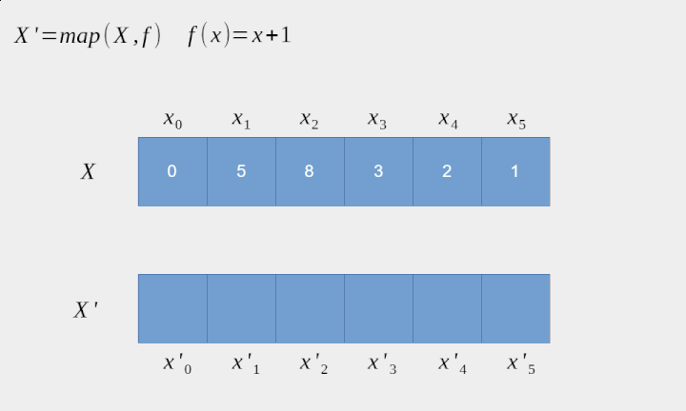

Slide 66
Operations Contd..
filter(P, S): returns the subset containing all elements of S that satisfy a given predicate P.
clear(S): delete all elements of S.
equal(S₁, S₂): checks whether the two given sets are equal (contain all and only the same elements).
hash(S): returns a hash value for the static set S such that if equal(S₁, S₂) then hash(S₁) = hash(S₂)

Slide 68
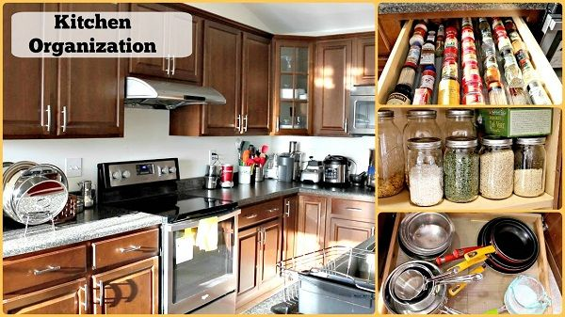
Applications of Sets
Kitchen - The plates are kept separate from bowls and cups. Sets of
similar utensils are kept separately.

Slide 69
Applications of Sets
School bags - There are usually divisions in the school bags, where the sets of notebooks and textbooks are kept separately.
Shopping malls - There are separate portions for each kind of things.
For instances, clothing shops are on another floor whereas the food
court is at another part of the mall.
Universe - There are millions of galaxies present in our world which are separated from each other by some distance. Here, the universe act as a set.

Slide 70

Universe

Slide 71
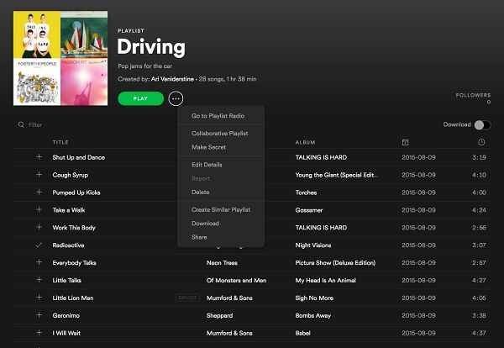
Applications of Sets
Playlist - Most of us have a different kind of playlists of songs present in our smartphones and computers. Rock songs are often separated from
classical or any other genre. Hence, playlists also form the example of
sets.

Slide 72
Applications of Sets
Rules - Every school or company have different sets of rules which have to
follow by every student and employee. There are disciplinary rules,
rules for leave, hostel rules, Timing rules, and many others. Hence, all
different types of rules are separated from others.
Representative house –
Here the people belonging to various departments have to sit separately
from other departments. For example, the legal department and finance
department don’t sit intermixed with each other. It has the lower house and upper house called Senate, where only senior members sit whereas the
juniors sit in the lower house.

Slide 73
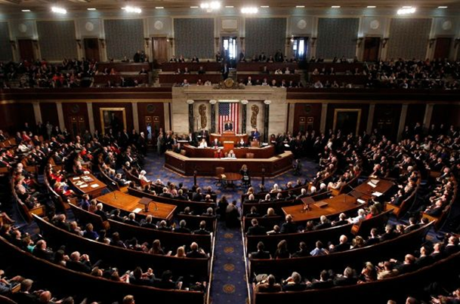
Representative house

Slide 74

Questions for you
1. The union of the sets {1, 2, 5} and {1, 2, 6} is the set _____________
a) {1, 2, 6, 1}
b) {1, 2, 5, 6}
c) {1, 2, 1, 2}
d) {1, 5, 6, 3}
2. The intersection of the sets {1, 2, 5} and {1, 2, 6} is the set ________
a) {1, 2}
b) {5, 6}
c) {2, 5}
d) {1, 6}

Slide 75
3. The difference of {1, 2, 3} and {1, 2, 5} is the set ____________
a) {1}
b) {5}
c) {3}
d) {2}
4. Two sets are called disjoint if their_____________ is the empty set.
a) Union
b) Difference
c) Intersection
d) Complement

Slide 76
5. Which of the following two sets are disjoint?
a) {1, 3, 5} and {1, 3, 6}
b) {1, 2, 3} and {1, 2, 3}
c) {1, 3, 5} and {2, 3, 4}
d) {1, 3, 5} and {2, 4, 6}
6. The complement of the set A is _____________
a) A – B
b) U – A
c) A – U
d) B – A

Slide 77
7. The bit string for the set {2, 4, 6, 8, 10} (with universal set of natural numbers less than or equal to 10) is ____________________
a) 0101010101
b) 1010101010
c) 1010010101
d) 0010010101
8. Let Ai = {i, i+1, i+2, …..}. Then set {n, n+1, n+2, n+3, …..} is the ______ of the set Ai.
a) Union
b) Intersection
c) Set Difference
d) Disjoint

Slide 78
9. The bit strings for the sets are 1111100000 and 1010101010. The union of these sets is ___________
a) 1010100000
b) 1010101101
c) 1111111100
d) 1111101010
10. The set difference of the set A with null set is __________
a) A
b) null
c) U
d) B

